Slide 1
JAVASCRIPT

Slide 2
Functions
A function is a block of code that performs a specific task.
JavaScript functions are basically used to encapsulate logic, making that code more reusable and easier to understand.
In JavaScript, functions are first-class objects, because they can be passed to other functions, returned from functions, and assigned to variables and properties.

Slide 3
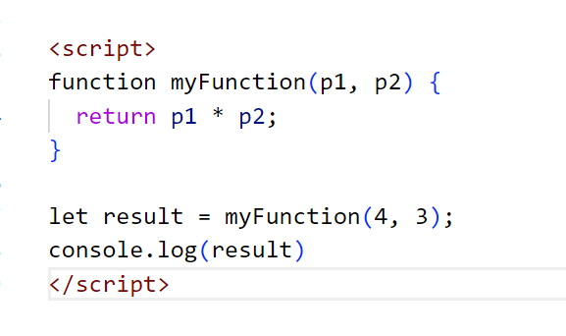
Function Statement

Slide 4
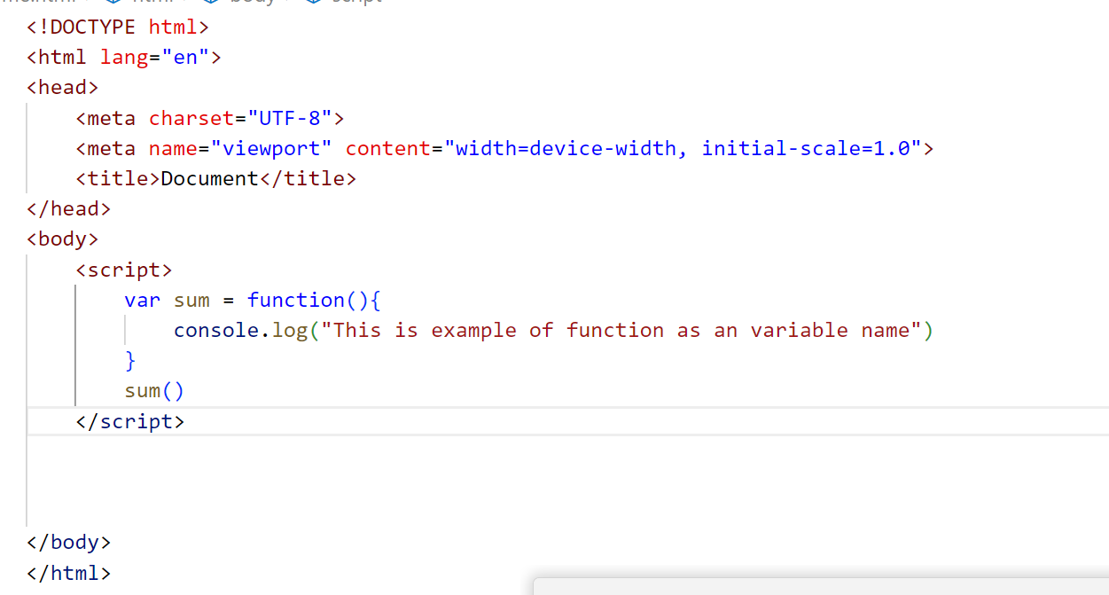
Function as Variable (function Expression)

Slide 5
Arrow Function
The arrow function syntax is a shorthand version of the regular function syntax
ES6 Arrow functions enable us to write functions with simpler and shorter syntax and make our code more readable and organized.
The arrow functions are introduced in the ES6 version.
Arrow functions provides us with a more precise approach to writing JavaScript Functions.

Slide 6
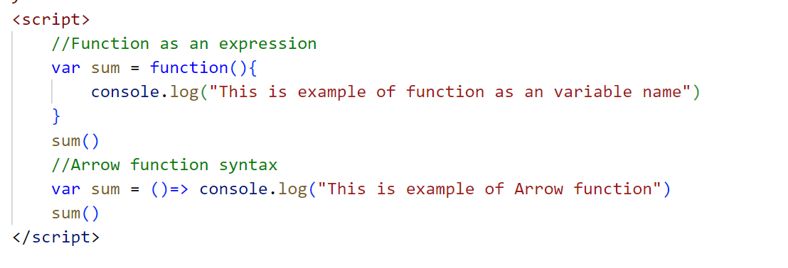

Slide 7
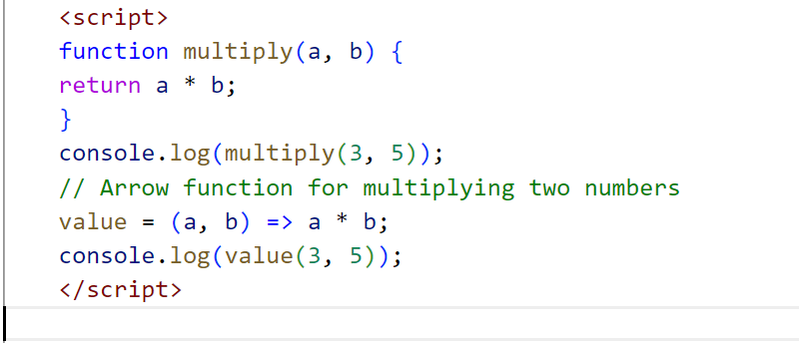
Arrow function

Slide 8
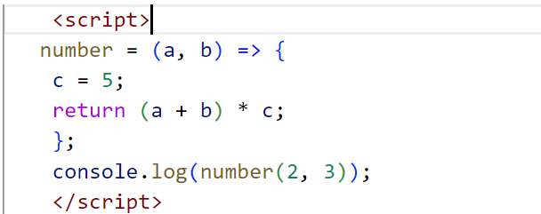
Arrow function

Slide 9
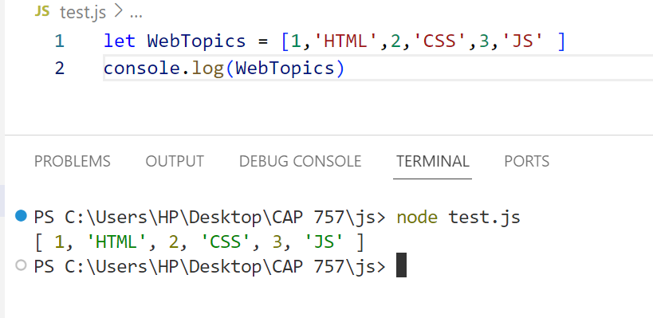
Array
In JavaScript, an array is an object constituted by a group of items having a specific order.
Arrays can hold values of mixed data ty
pes and their size is not fixed.

Slide 10
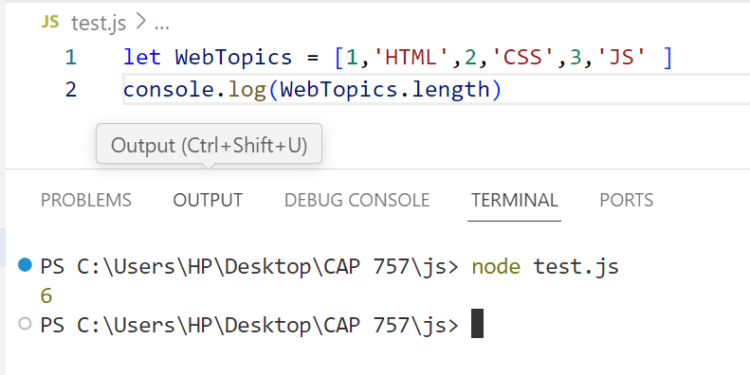
Length

Slide 11
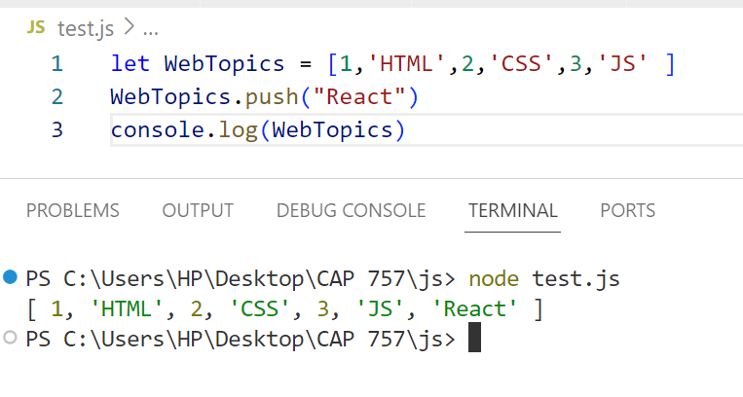
PUSH

Slide 12
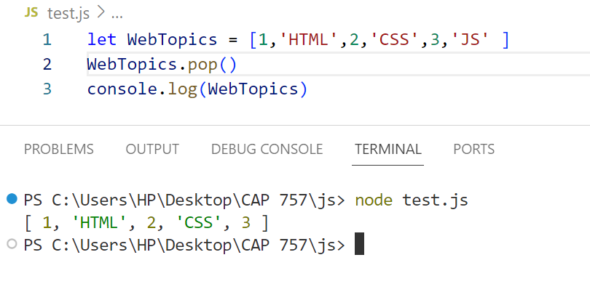
POP

Slide 13
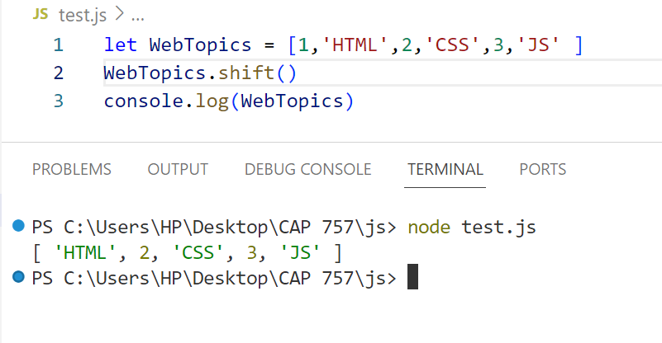
Shift

Slide 14
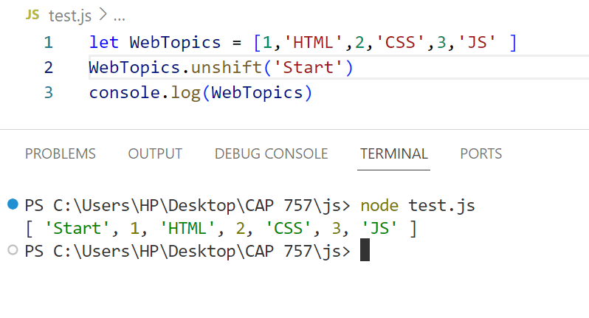
Unshift

Slide 15
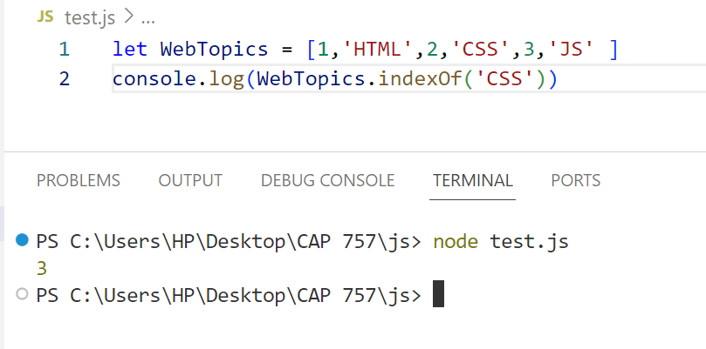
IndexOf

Slide 16
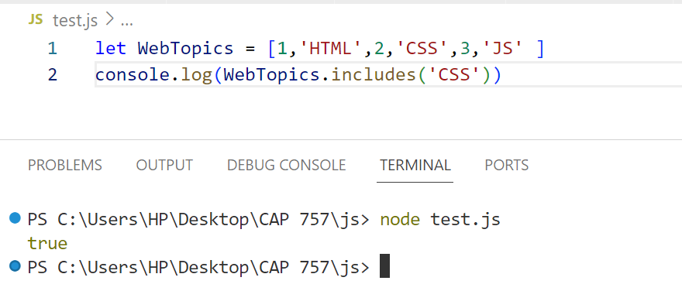
Includes

Slide 17
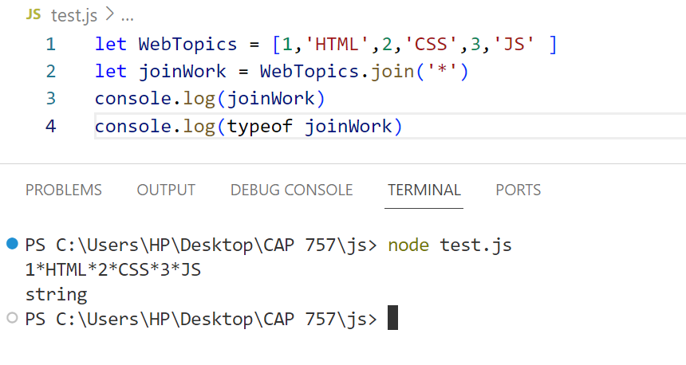
Join

Slide 18
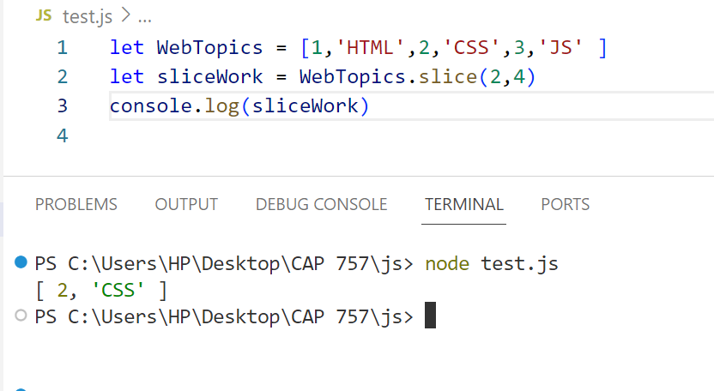
Slice

Slide 19
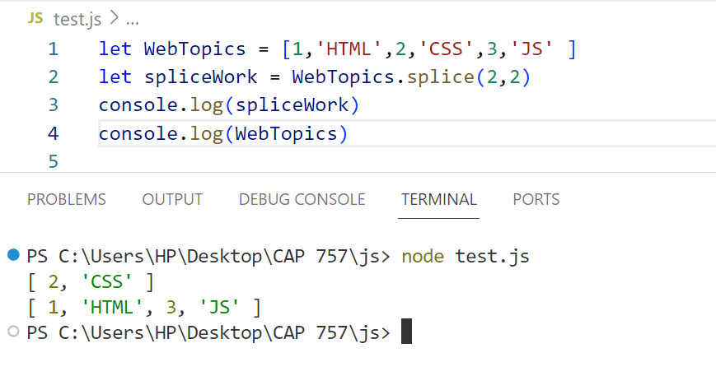
Splice

Slide 20
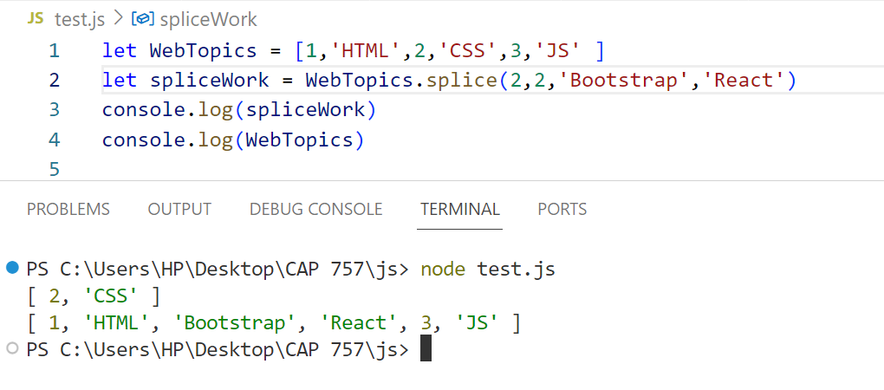
Splice

Slide 21
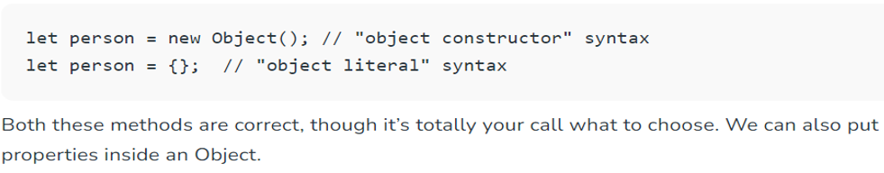
Objects
JavaScript is designed on a simple object-based paradigm.
An object is a collection of properties, and a property is an association between a name (or key) and a value.
Compare it with a cup, for example. A cup is an object, with properties. A cup has a color, a design, weight, a material it is made of, etc. The same way, JavaScript objects can have properties, which define their characteristics.

Slide 22
Object
In JavaScript, almost "everything" is an object.
Booleans can be objects (if defined with the new keyword)
Numbers can be objects (if defined with the new keyword)
Strings can be objects (if defined with the new keyword)
Dates are always objects
Maths are always objects
Regular expressions are always objects
Arrays are always objects
Functions are always objects
Objects are always objects

Slide 23
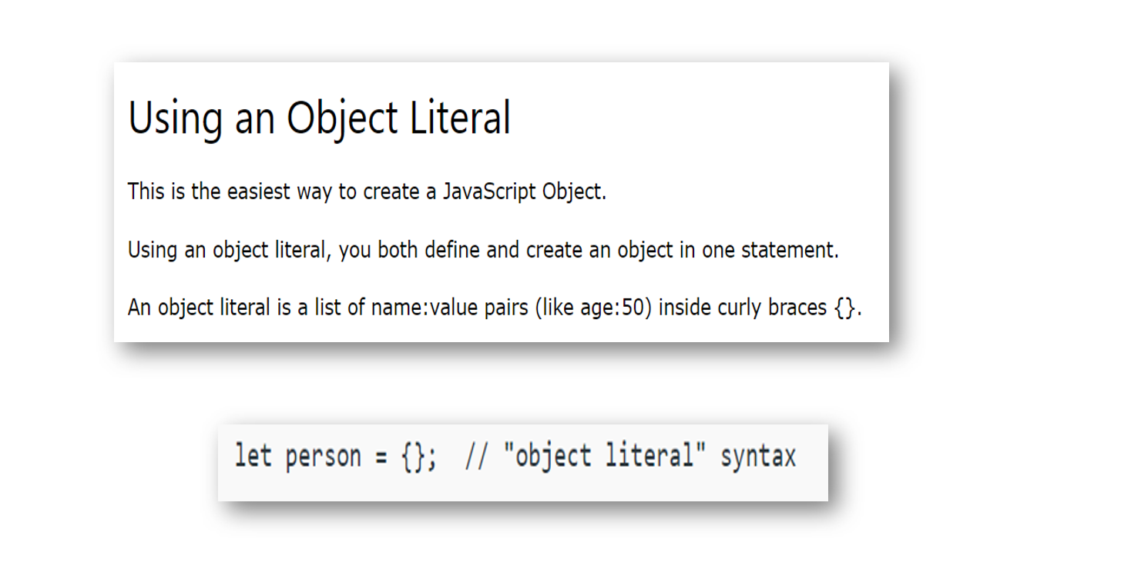

Slide 24
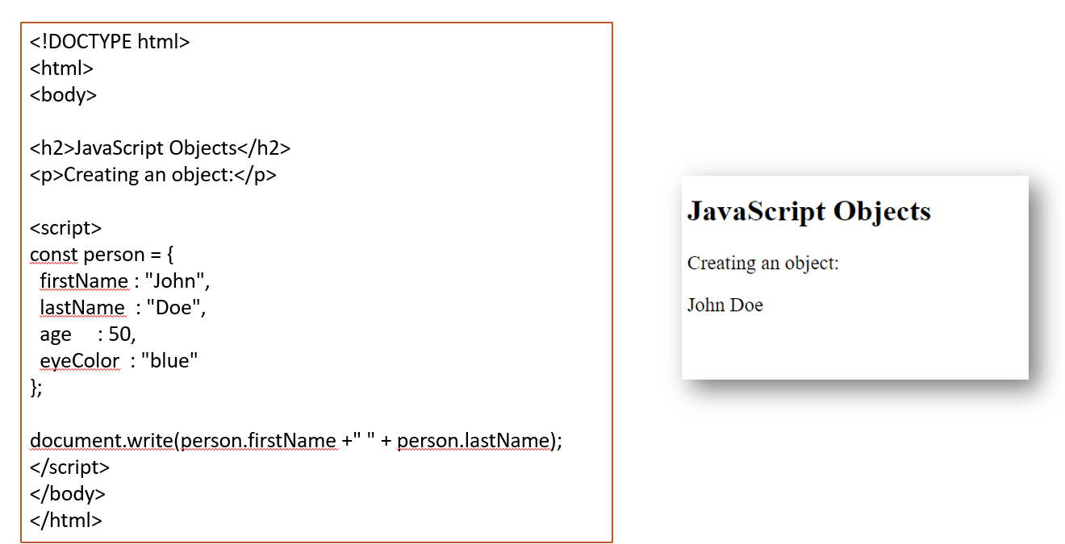

Slide 25
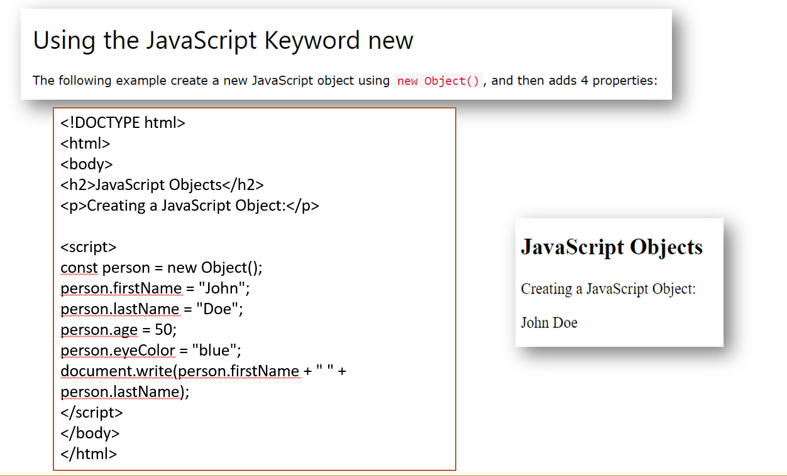

Slide 26
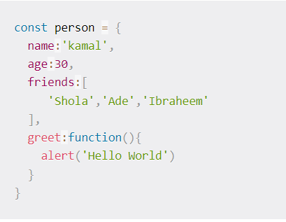
Object Literal Method

Slide 27
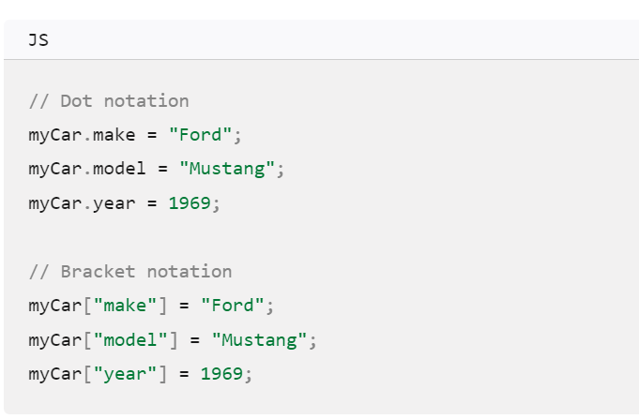

Slide 28
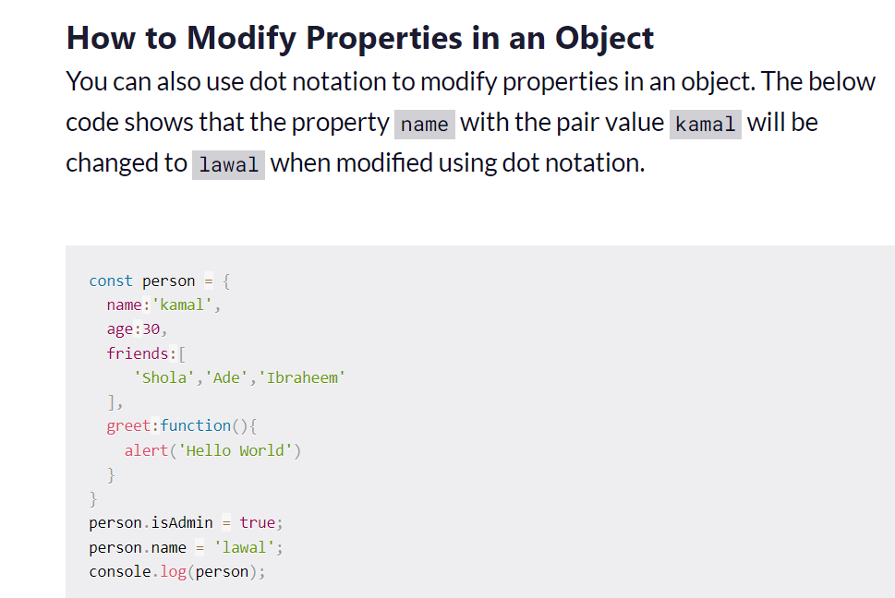

Slide 29
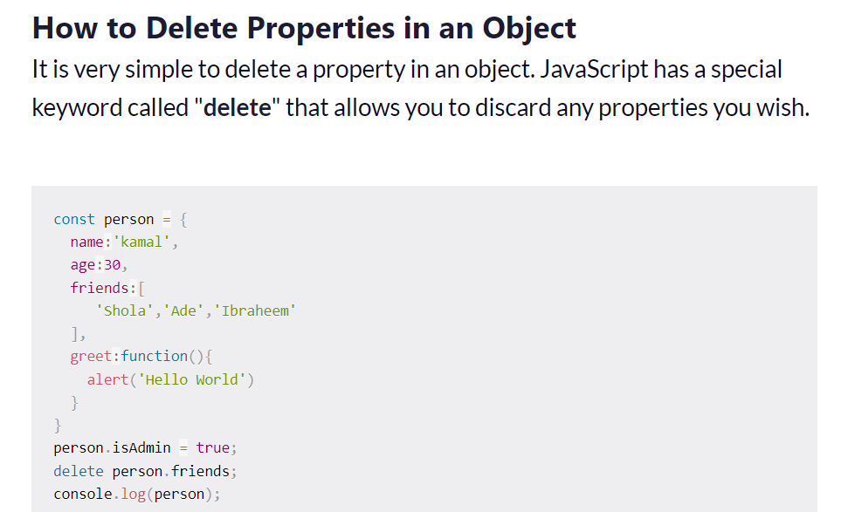

Slide 30
Class
In JavaScript, Classes define blueprints for creating objects with similar properties and methods.
Classes are similar to functions. Here, a class keyword is used instead of a function keyword. Unlike functions classes in JavaScript are not hoisted. The constructor method is used to initialize. The class name is user-defined..

Slide 31
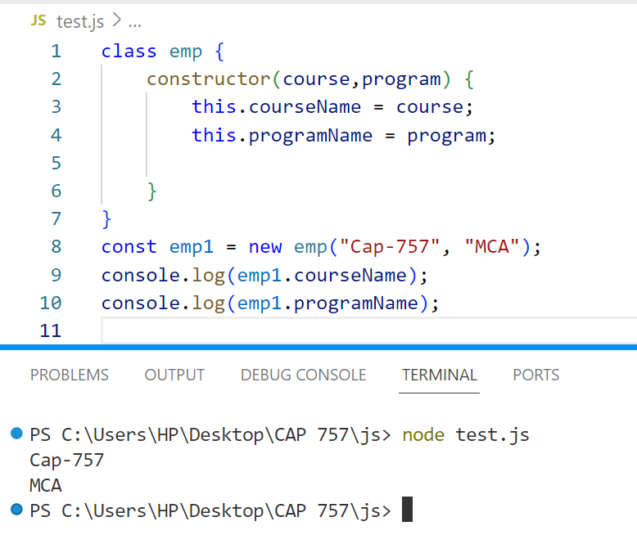

Slide 32
Modules
A module in JavaScript is just a file containing related code.
A module is just a piece of code in a file that you can call and use from other files.
In JavaScript, we use the import and export keywords to share and receive functionalities respectively across different modules.
The export keyword is used to make a variable, function, class or object accessible to other modules. In other words, it becomes a public code.
The import keyword is used to bring in public code from another module.

Slide 33
Two Ways of creating Module
Module
Common JS
ES6 Modules

Slide 34
CommonJS
CommonJS is a set of standards used to implement modules on JavaScript.
CommonJS is mainly used in server-side JS apps with Node, as browsers don't support the use of CommonJS.

Slide 35
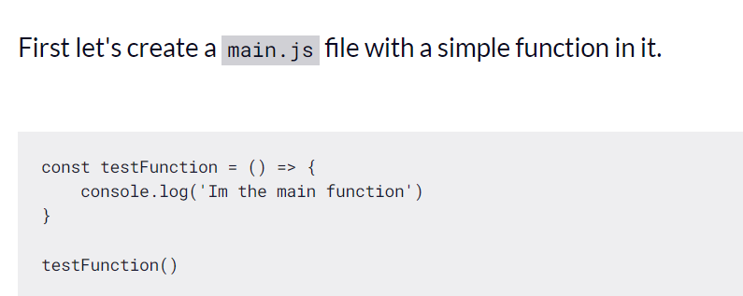

Slide 36
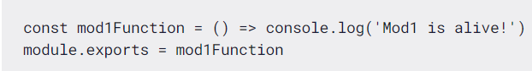
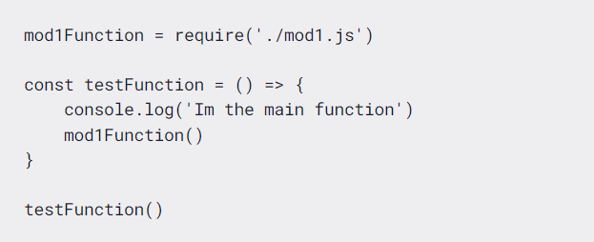
Suppose you create Another file mod1.js now in this file you have created a function
module.exports is the keyword we use to declare all we want to export from that file.
To use this function in our main.js file, we can do it like this:

Slide 37
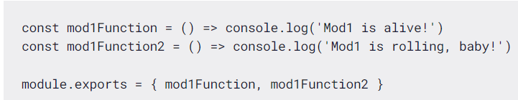
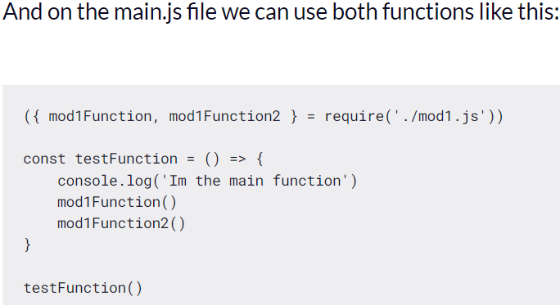
If We want to export more than one thing from a single module then we can do it like this:

Slide 38
ESmodules
ESmodules is a standard that was introduced with ES6 (2015).
ESmodules is a more modern approach that is currently supported by browser and server-side apps with Node.
With ES Modules we use Import Keyword to use method in different file

Slide 39
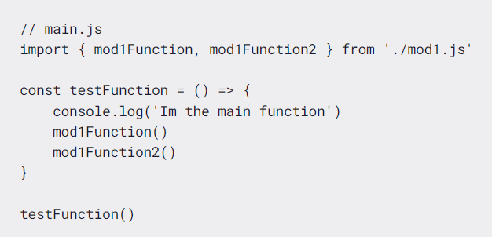

Slide 40
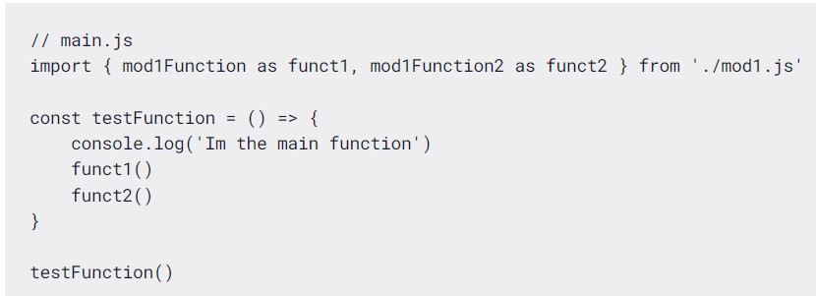
Another feature available in ESmodules is import renaming, which can be done like this:

Slide 41
Transpiler
A transpiler, short for "transformation compiler," is a tool that converts code written in one programming language into another programming language, while preserving the original functionality.
In the context of JavaScript, transpilers are used to convert code written in the latest version of JavaScript (ES6 or later) into an earlier version that is more widely supported by browsers and other environments.

Slide 42
Why are Transpilers Useful?
Modern Syntax Adoption: Transpilers empower developers to utilize the latest JavaScript syntax, enhancing code readability and maintainability.
Cross-Platform Compatibility: Developers can target a wider range of environments, including older browsers and devices, ensuring seamless compatibility without compromising code quality.
Performance Optimization: Transpilers optimize JavaScript applications by converting code into earlier versions, reducing download and execution requirements, thus improving page load times and overall application performance.

Slide 43
Babel
Well, all the latest javascript features are not supported in every browser yet.
So Something is required to convert it.
babel is here to transpile latest javascript features(ES6 features) which are not understandable to every browser to ES5 which is understandable to every browser.

Slide 44
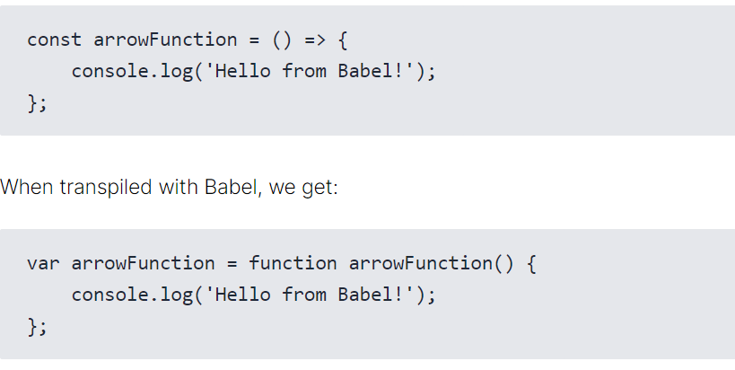

Slide 45
Promises in JS
A Promise is an object representing the eventual completion or failure of an asynchronous operation.
It produces a value after an asynchronous operation completes successfully, or an error if it does not complete successfully due to time out, network error, and so on.
Successful call completions are indicated by the resolve function call, and errors are indicated by the reject function call.
You can create a promise using the promise constructor like this:

Slide 46
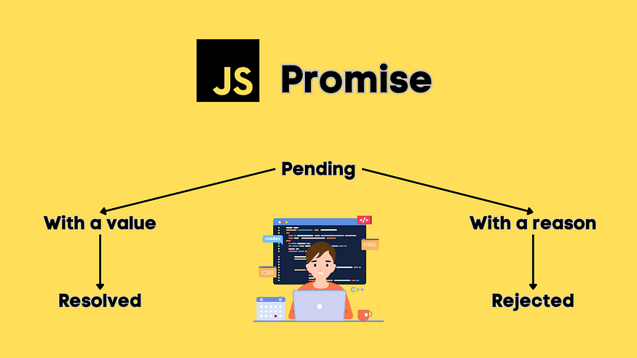

Slide 47
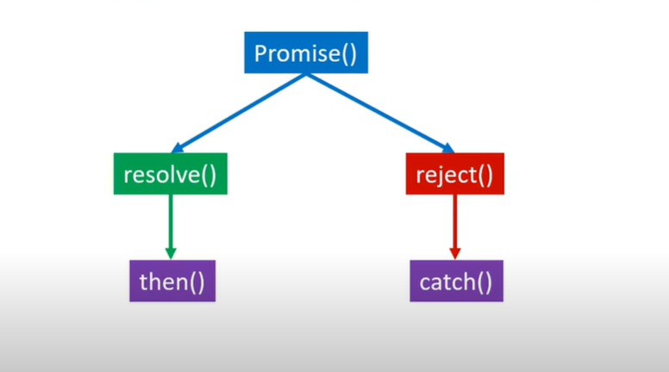
Then() & catch both are call back functions.
Inbuilt functions are used in javascript

Slide 48
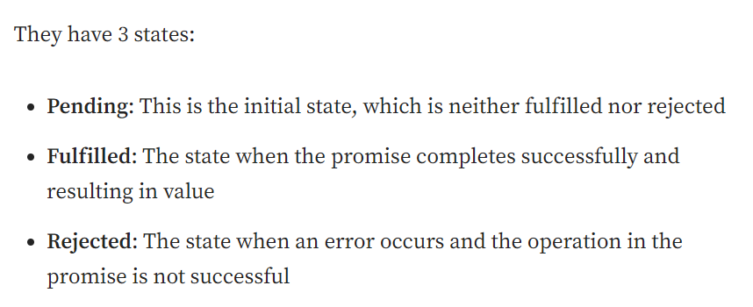

Slide 49
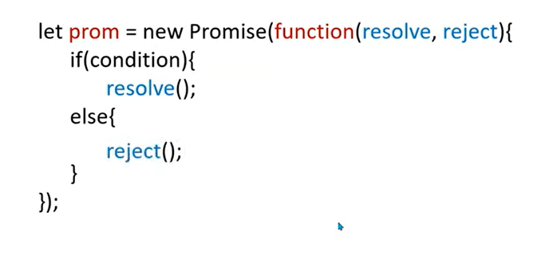
If Condition is true than call resolve()
If Condition is false than call reject()

Slide 50
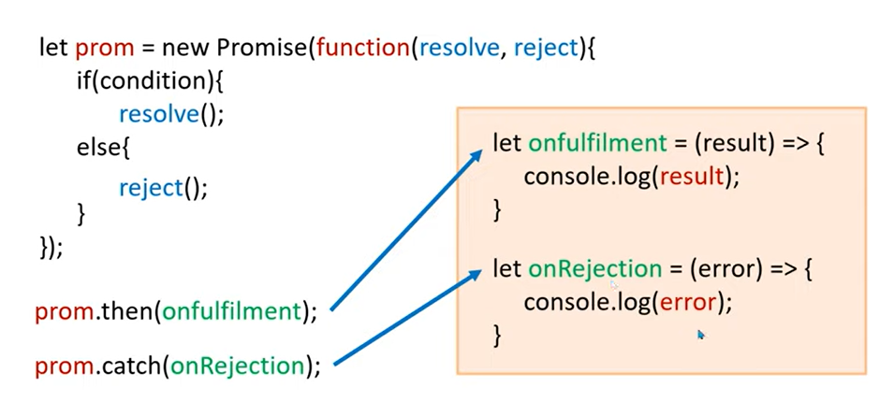

Slide 51
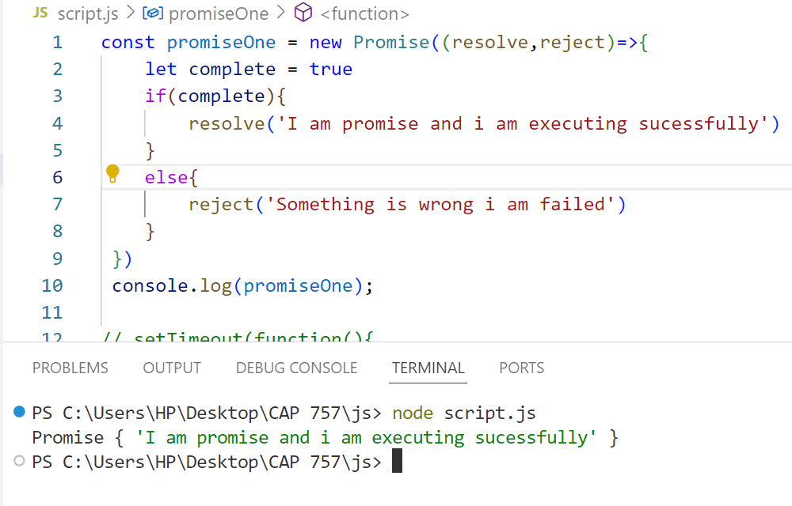

Slide 52
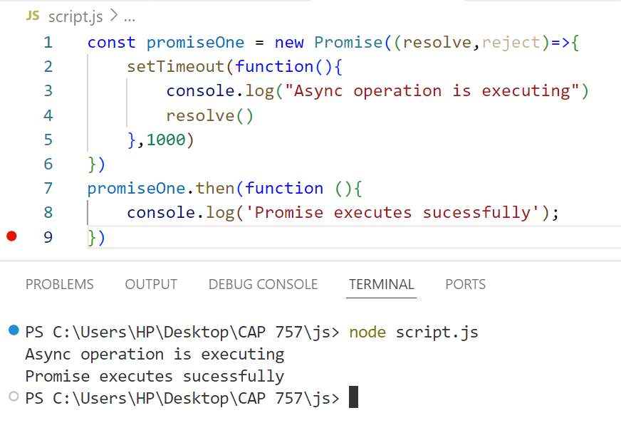

Slide 53
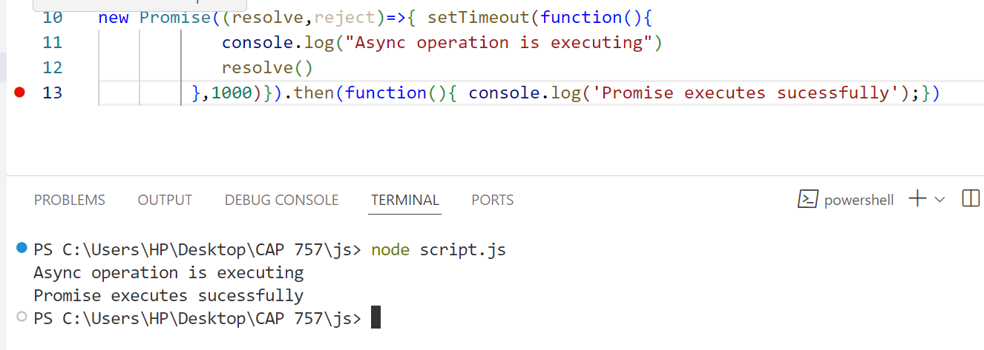

Slide 54
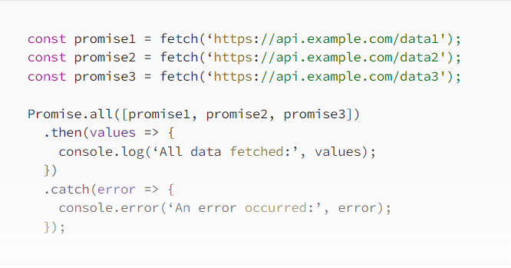

Slide 59
Declarative/ Imperative
Declarative programming is a paradigm describing WHAT the program does, without explicitly specifying its control flow.
Imperative programming is a paradigm describing HOW the program should do something by explicitly specifying each instruction (or statement) step by step, which mutate the program's state.

